Slide 1


Slide 2


WOSM’s Capacity Strengthening approach for National Scout Organizations
Capacity Strengthening

Slide 3

What is WOSM’s Capacity
Strengthening Approach?
Notes:
Vision 2023 – enabling 100 million young people to be active citizens creating positive change in their communities and in the world based on shared values.
Membership growth - To achieve membership growth it is not only important to have a quality scouting experience, but also a strong organizational foundation
Building capacity of NSOs around the world through the various support mechanisms in place,
1) connecting NSOs with other NSOs to share best practices
2) Understanding strengths and areas of improvement through assessment using GSAT
3) Aligning and innovating against international best practices
4) WOSM Services and support from World Scouting

Slide 4


Assessing
GSAT is used to assess
strengths & areas of
improvement
Help NSO assess its
current capacity
Monitoring
Prioritizing
Help NSO monitor
results and tell their story
WOSM’s Capacity
Strengthening Cycle
Prioritize Action
Plan
Quality of delivery,
and progress is monitored on
the WOSM Service Platform
Action Plans are
created, ensuring buy-in
and setting priorities
Supporting
WOSM Services are
delivered in line with
Action Plans
Assist NSO to identify
support
Notes:
Assessing
Prioritizing
Supporting
Monitoring

Slide 5

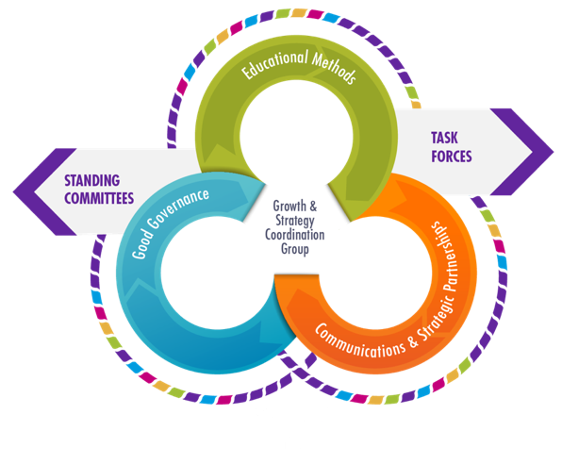
World Triennial
Plan 2017-2020
By 2020, 75% of NSOs will complete a GSAT assessment.
Notes:
Good Governance
Continue the implementation and further development of Global Support Assessment Tool as WOSM’s standard for NSOs and ensure follow-up on its results.
By 2020, 75% of NSOs will complete a GSAT assessment.

Slide 6

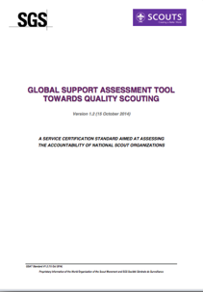
World Scouting’s Quality
Standard
Based on Good Governance and Quality Scouting principles
Developed in cooperation with SGS
Tailored for WOSM
Notes:
GSAT is World Scouting’s stamp of quality for National Scout Organisations (NSOs), establishing standards of good governance and quality Scouting that mirror international best practice.
This tool was developed in cooperation with an external organisation, specialized in Certification of NGOs called SGS
And the tool is tailored for WOSM which means that is it was based on evaluation tools that already existed on the Regional Levels, such as the NSO Check List, the Route to Excellence in IAR and the CNV (Committee NSO Visit) in APR.

Slide 7






Objectives
Measurement of quality
A tool for improvement
Taking action together
Growing our movement
Commitment to excellence
Notes:
Benchmark - Measurement of quality - A cross-regional assessment tool that gives NSOs the opportunity to measure themselves against established global standards
Assessment - A tool for improvement - GSAT offers NSOs the ability to evaluate their own operations, and identify strengths and areas for improvement
Addressing priorities - Taking action together - Successful and efficient follow-up of assessments allows World Scouting to address the priorities, not only of NSOs, but also our Movement as a whole; guiding our actions for the future
Capacity strengthening - Growing our Movement - GSAT enables World Scouting to improve its support for NSOs, based on the needs and trends identified through the GSAT assessments, enhancing the capabilities of our Movement
Continuous improvement - Commitment to excellence - GSAT encourages the on-going development of our Movement to bring about purposeful change.

Slide 8











10
Dimensions
Notes:
Our 10 GSAT Dimensions

Slide 9

96
Objectively
Verifiable
GSAT Criteria
GSAT Criteria 608: Adult training
The NSO has a clear training and personal development framework for adults (both professional staff and volunteers). Each training curriculum has clear objectives, the minimum competencies required and is regularly reviewed.

Slide 10
How does it work?
Scored between 0 to 3
Evidence based
15 Red Flags
(Major Non-Conformities)
5 Key Dimensions
  D02 – Governance Framework
  D03 – Strategic Framework
  D06 – Adults in Scouting
  D07 – Resources Allocations and
  Financial Controls
  D08 – Youth Programme

Slide 11

GSAT Assessment Methods | GSAT Self-Assessment | WOSM Assessment | GSAT Audit
Conducted by | National Scout Organization | WOSM Assessor | SGS Auditor
Preparation time | 1+ month | 2+ weeks | 2+ weeks
Delivered | Online or in-person | In-person | In-person
Duration | 2 days to 2 months | 4 days | 4 days
Support | Virtual GSAT Facilitator | Virtual or In-person GSAT Facilitator | In-person GSAT Facilitator
Notes:
Three version using the same tool from Audit to Self-Assesment.
1. stepstone approach: this is a classic approach where the NSO first tries out the self-evaluation internally, then asks the Region to conduct a 2nd party assessment, and so ultimately going for the 3rd party. The added value in this approach is that the NSO gets time to become acquainted with GSAT and is adequately prepared for each step, resulting in a higher chance for eventual certification.
2- regionally guided apprach: in this approach the Region takes an active role in selecting which NSO is ready for a specific model, and then liaises directly. This also allows a Region to build a robust dataset of GSAT results which can be used to finetune their own support processes.
3. donor-driven approach: an NSO might be interested, due to the potential or willingness to attract new donors, to aim for certification. In such a case a 3rd party audit might be immediately opted for after recommendation by the Region.

Slide 12

Why do a GSAT
Self-Assessment?
Help define your Strategic Plan
Identify strengths and areas for improvement
Strengthen capacity through WOSM Services
Prepare for or follow-up on a previous GSAT Assessment

Slide 13


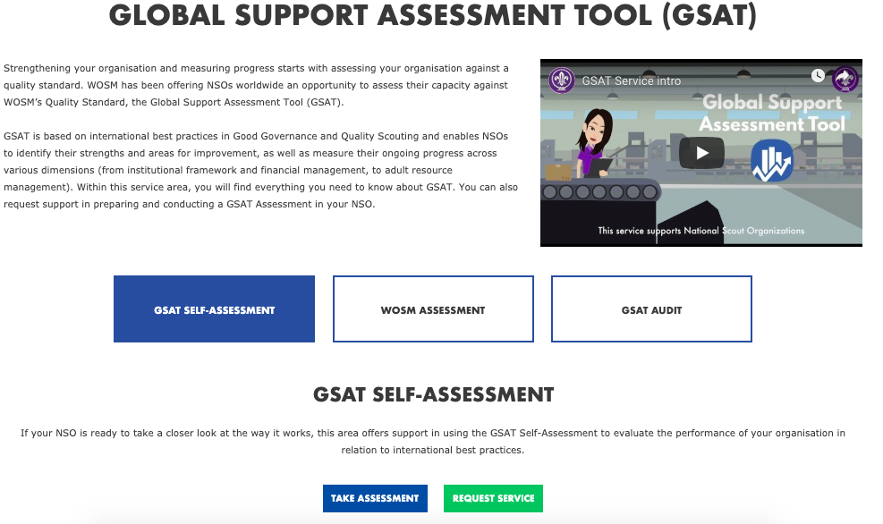
Requesting a GSAT Service
services.scout.org
Notes:
Can request on the WOSM Service Platform for support to do a GSAT Self-Assessment
A selection of consultants are trained around the world to support GSAT – trained to understand the tool and support NSOs in preparing for and undergoing an assessment
A consultant can be assigned to support either in-person or virtually depending on capacity building plans within the Region and budget availability
While NSOs are always encouraged to do a GSAT Self-Assessment and can use our Guidelines as a resource to complete one themselves, we ask that they at least notify the Region that they are doing a GSAT Self-Assessment and then even share the results.
Results are kept confidential and only shared with specific staff or assigned consultants to support the NSO in strengthening their capacity.

Slide 14
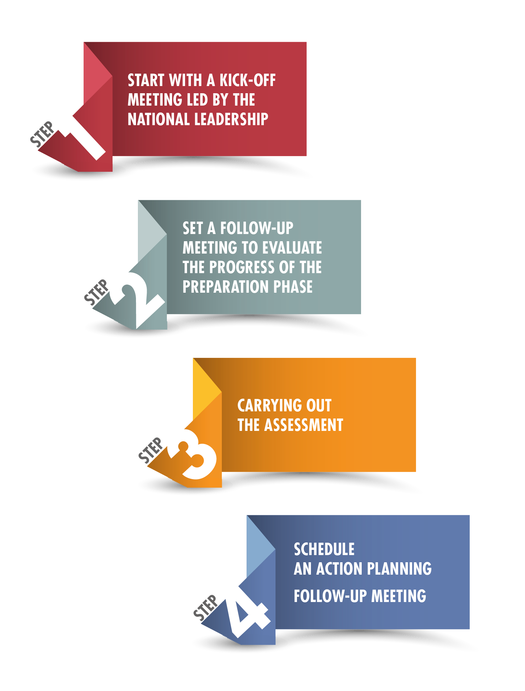
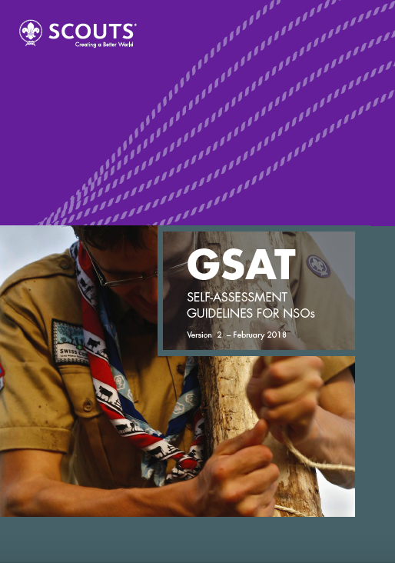
Recommended
Process
Notes:
Guidelines available on the GSAT Service page
A flexible approach
By team
Bring everyone together
Do over time or over one weekend
Good to have the key people in charge of different areas be part of the discussion and scoring
Evidence, Evidence, Evidence

Slide 15
STATUS | EXPLANATION | SCORE
NON COMPLIANT | No evidence at all exists that the NSO has done anything around this criterion. | 0
IN ACCORDANCE WITH FEW ITEMS | Evidence exists that the NSO has done some things (but not all) around this criterion. | 1
IN ACCORDANCE WITH MOST ITEMS | Evidence exists that the NSO has most things around this criterion. It is up-to-date and implemented. | 2
FULL COMPLIANCE | Evidence exists that the NSO has everything around this criterion. It is up-to-date, implemented, regularly evaluated and refreshed. | 3
NOT APPLICABLE | Not applicable due to the local circumstances or in relation to another non compliant criterion. | n/a
Notes:
Important to note that you do not pass or fail GSAT, you however gain an understanding in your strengths and areas for improvement and assess capacity and a way forward to strengthening that capacity
0=NO / 3=YES
Score 0: no evidence at all exists that the NSO has done anything around this criteria
Score 1: evidence exists that the NSO has done something in the past around this criteria
Score 2: evidence exists that the NSO has an up-to-date and implemented policy around this criteria
Score 3: evidence exists that the NSO has an up-to-date and implemented policy around this criteria, that is regularly evaluated and refreshed

Slide 16

Scoring Example
203: The NSO’s "National Board" and "General Assembly" take decisions by a simple majority of votes cast, except for changes to the Constitution and Dissolution, which require a qualified majority.
If there are no rules | 0
If there is a rule to take decisions by simple majority. Constitution and Dissolution are not mentioned | 1
If there is a rule to take decisions by simple majority for all decisions including changes to Constitution and Dissolution | 2
If as per criteria | 3

Slide 17

GSAT Service
services.scout.org/service/9
Notes:
Access all the resources for GSAT to learn more

Slide 18

Questions?

